Slide 1

HealthCare Management System
Project by
Deeksha Khajuria - 001027844
Riya Moitra - 001528940
Aakash Shukla - 001557554
Srividya Burra - 002985163
Siddhi Telang - 002198703

Slide 2
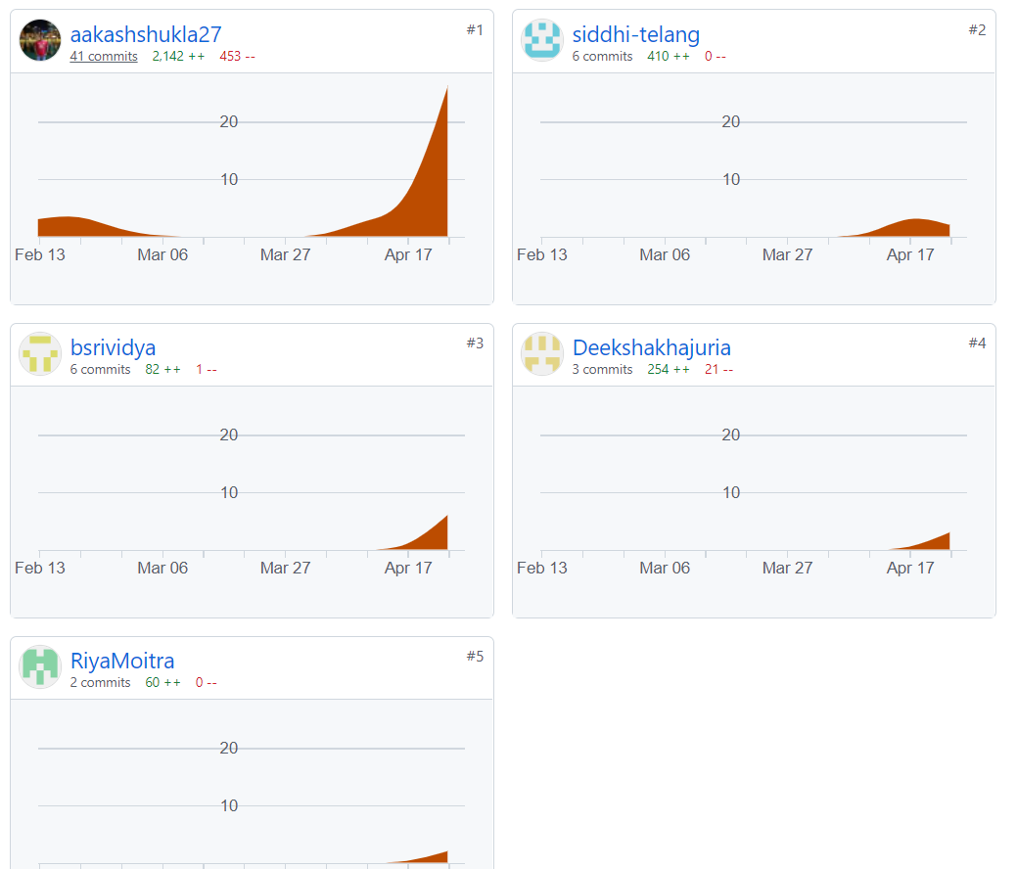
Github Contibuters

Slide 3
Team Contribution
Deeksha Khajuria-Tables, Constraints, stored procedures
Riya Moitra- Tables, Views, Presentation, Report
Aakash Shukla – Stored procedures, Views, Report, Presentation, Tables, Triggers, Functions, Constraints, ER Diagram
Srividya Burra - Dummy data creation
Siddhi Telang – Dummy data creation, ERD

Slide 4
Problem Statement
Healthcare industry is experiencing a massive transition. The erstwhile legacy manual filing system has plethora of problems associated with it. Some of these problems include insecurities of files, inefficient retrieval, inefficient billing system, data portability etc. to name a few.
According to PwC’s report there are 5 main aspects that are driving this growth.
1. Growing influence of consumerism – Patients have a greater access to data, and it is easier for them to find options that suit them well. It has become easier for healthcare providers to reach out to consumers.
2. Transition to value-based care – Transition to alternative payment models has yielded a more immediate, wide scale results and helped in producing new sources of revenue for healthcare facilities.
3. Widespread use of technology – With the shift to electronic health records, new technologies are changing the way clinics provide health care and how patients connect with them.
4. Decentralization of care – Remote patient monitoring and virtual clinics have brought care programs directly to patients. This decentralization has brought health care providers directly to consumers without the need to bring consumers to a centralized location.
5. Increased focus on wellness – There is an increased focus on personal health in the current times. Patients, insurers, and healthcare providers have all benefited from this.

Slide 5
Proposed Solution
For this project we are designing a healthcare management system to provide accessibility, data management and information transfer among various entities. We are integrating multiple entities including doctors, hospital staff, pharmacy, testing labs, hospital rooms, ambulances, patients etc. into a single unified system.
The system will have multiple views for the different categories of users.
• Doctors
• Lab Assistants
• Pharmacists
• Receptionists
• Patients
The system will also incorporate a role-based system that will provide a layer of abstraction as to who has access to what data as health records are considered confidential.
At the heart of the system will be a master employee and patient tables that will have records of all active and inactive staff and patients, respectively. Putting the nitty gritty aside we will have multiple tables channeling data to demonstrate normalization.

Slide 6
Key Features
Appointment Scheduling.
Electronic Health Records.
Accounting Management.
Doctors' Information.
Inventory management for Pharmacy.
Laboratory Management.
Cumulative Bill generation.
Insurance record management
Hospital rooms availability/reservation.
Employee Information.
Payroll management.

Slide 7
Implemented Concepts
Relational Database (Relationships)
Cardinality
Ordinality (Modality)
SQL Constrains
Normalization
Triggers
Keys – Primary, foreign, unique
Data Integrity
Views
Joins
Transactions
Subqueries
SQL Sequence
Functions

Slide 8
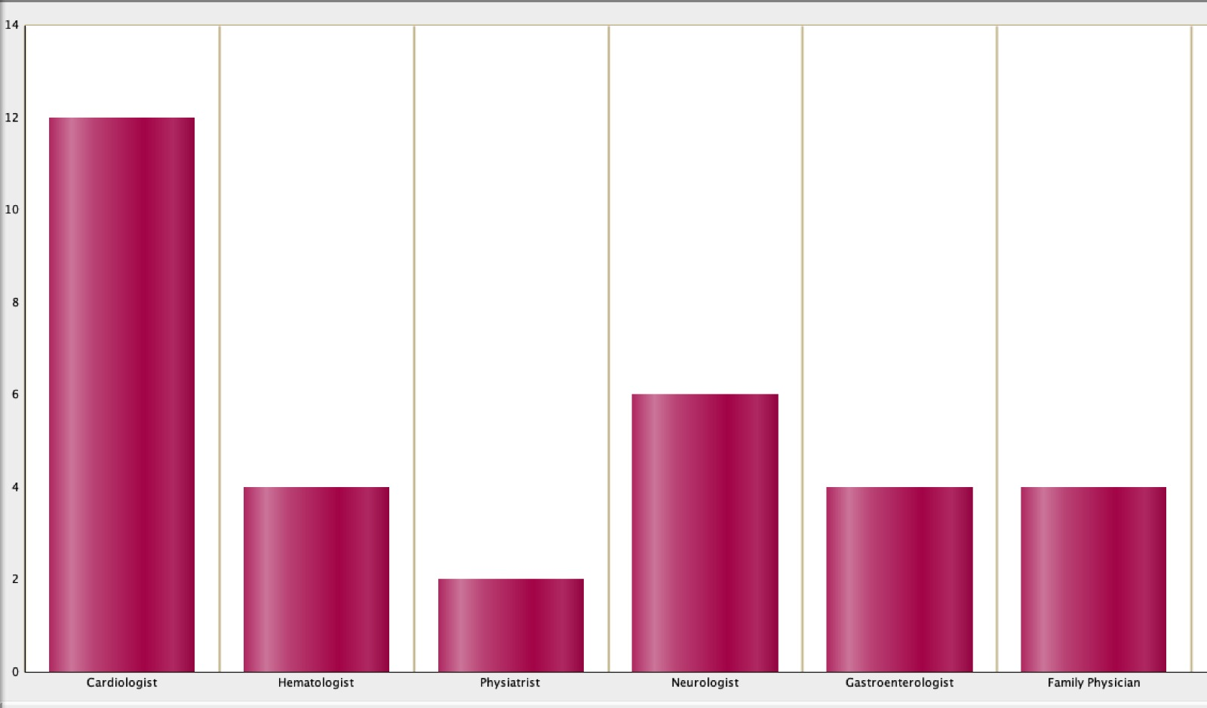
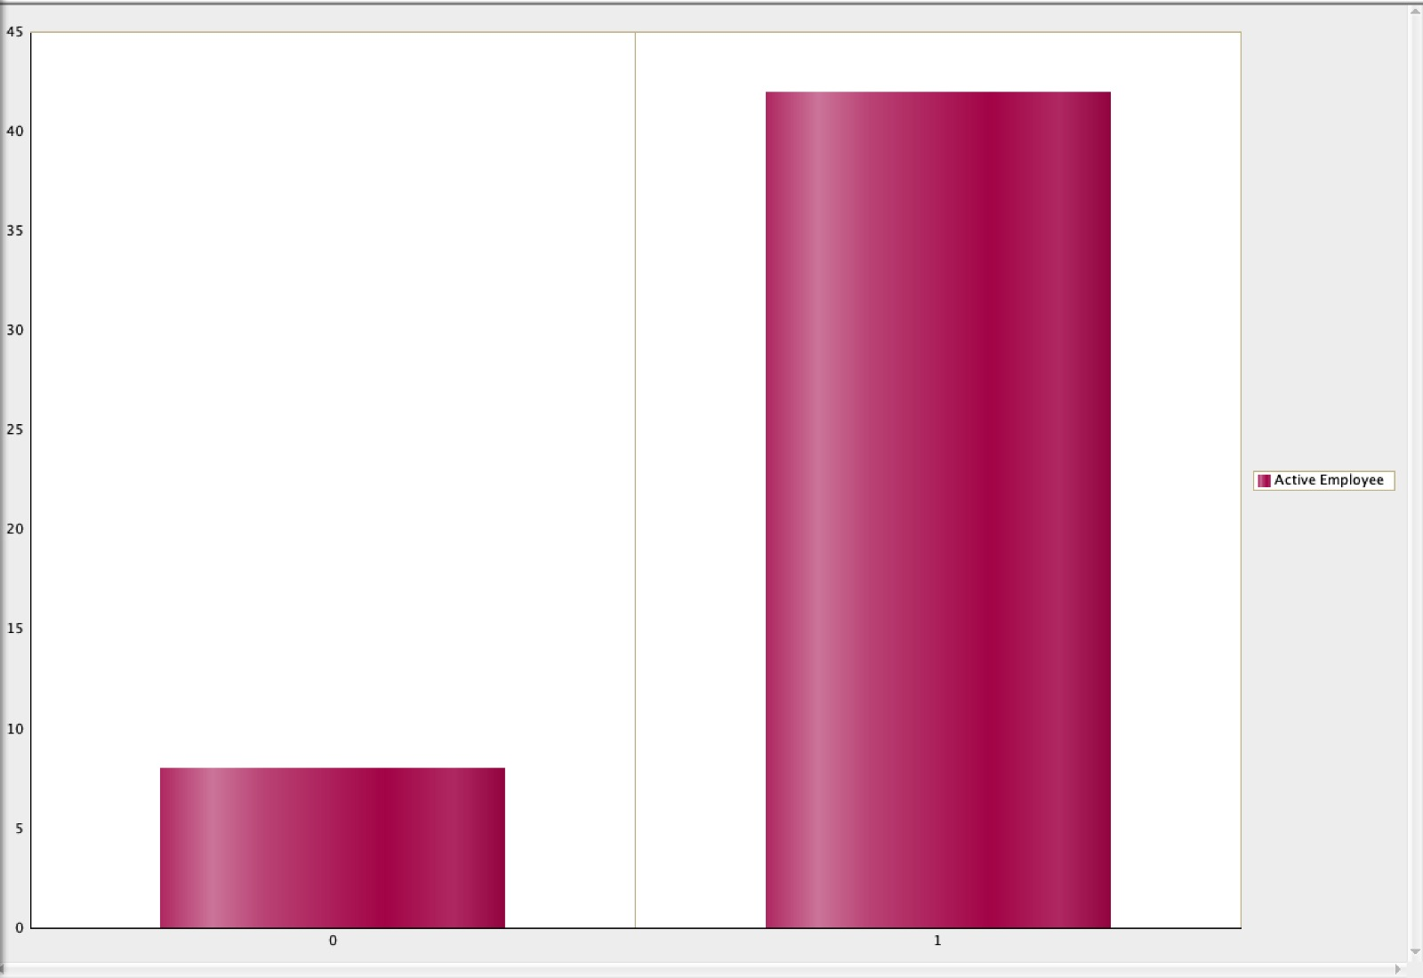
Reports

Slide 9
THANK YOU

